Slide 1
Work-Ready Employment Assistance Program

Slide 2
Facilitators
Gary Jensen, (Army)
  Missouri Workforce Training Technician

Slide 3
Workshops
(What we will cover)
Translating Military Skills
Skills Gap Analysis (Overview)
Developing a Career Portfolio
The Problem with the On-Line Job Process
Resume Review
Interview Techniques
Networking
Elevator Speech
Social Media

Slide 4

Why Hire a Vet

Slide 5
Top Ten Reasons Employers Hire Vets
Accelerated Learning Curve
Leadership
Teamwork
Diversity and Inclusion in Action
Efficient Performance under Pressure
Respect for Procedures
Technology and Globalization
Integrity
Conscious of Health and Safety Standards
Triumph over Adversity
Military.com
Notes:
Accelerated learning curve.
Veterans have the proven ability to learn new skills and concepts. In addition, they can enter your workforce with identifiable and transferable skills, proven in real-world situations. This background can enhance your organization's productivity.
Leadership.
The military trains people to lead by example as well as through direction, delegation, motivation, and inspiration. Veterans understand the practical ways to manage behaviors for results, even in the most trying circumstances. They also know the dynamics of leadership as part of both hierarchical and peer structures.
Teamwork.
Veterans understand how genuine teamwork grows out of a responsibility to one's colleagues. Military duties involve a blend of individual and group productivity. They also necessitate a perception of how groups of all sizes relate to each other and an overarching objective.
Diversity and inclusion in action.
Veterans have learned to work side by side with individuals regardless of diverse race, gender, geographic origin, ethnic background, religion, and economic status as well as mental, physical, and attitudinal capabilities. They have the sensitivity to cooperate with many different types of individuals.
Efficient performance under pressure.
Veterans understand the rigors of tight schedules and limited resources. They have developed the capacity to know how to accomplish priorities on time, in spite of tremendous stress. They know the critical importance of staying with a task until it is done right.
Respect for procedures.
Veterans have gained a unique perspective on the value of accountability. They can grasp their place within an organizational framework, becoming responsible for subordinates' actions to higher supervisory levels. They know how policies and procedures enable an organization to exist.
Technology and globalization.
Because of their experiences in the service, veterans are usually aware of international and technical trends pertinent to business and industry. They can bring the kind of global outlook and technological savvy that all enterprises of any size need to succeed.
Integrity.
Veterans know what it means to do "an honest day's work." Prospective employers can take advantage of a track record of integrity, often including security clearances. This integrity translates into qualities of sincerity and trustworthiness.
Conscious of health and safety standards.
Thanks to extensive training, veterans are aware of health and safety protocols both for themselves and the welfare of others. Individually, they represent a drug-free workforce that is cognizant of maintaining personal health and fitness. On a company level, their awareness and conscientiousness translate into protection of employees, property, and materials.
Triumph over adversity.
In addition to dealing positively with the typical issues of personal maturity, veterans have frequently triumphed over great adversity. They likely have proven their mettle in mission critical situations demanding endurance, stamina, and flexibility. They may have overcome personal disabilities through strength and determination.

Slide 6
Translating Military Skills

Slide 7
Translating Military Skills
Military veterans often have a wide range of skills and talents civilian employers are seeking.
Most skill translators fail to account for integral aspects of military training and thus discount the veteran’s potential value to an employer.
Notes:
Military veterans often have a wide range of skills and talents civilian employers are seeking. But sometimes the veterans and the employers don’t speak the same language.
Computer based skill translators that do exist overly rely on categorizing veterans by their military occupation, as illustrated by
Most skill translators fail to account for integral aspects of an military training and thus discount the veteran’s potential value to an employer.

Slide 8

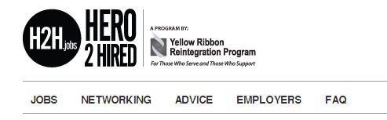
Online Skills Translators
CareerOneStop.org
H2H.jobs
Notes:
CareerOneStop has two translation portal and both provide similar results. 1st portal is at the Veterans Reemployment Link and 2nd link is located at the military transition link. Major differences is a keyword search on the 2nd link.
H2H.jobs translate keywords within your MOS and produces employment opportunities based on the skill word match

Slide 9
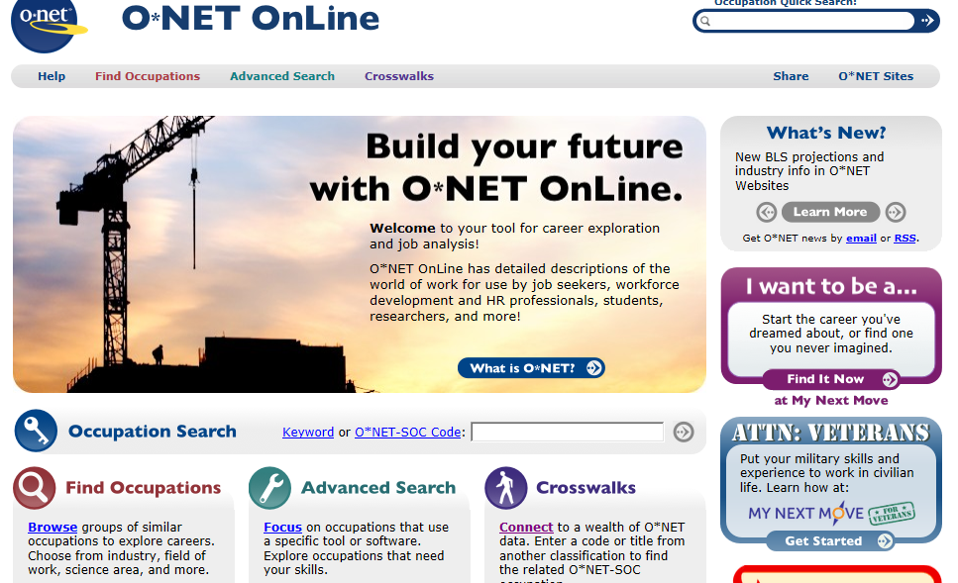
ONET Online

Slide 10
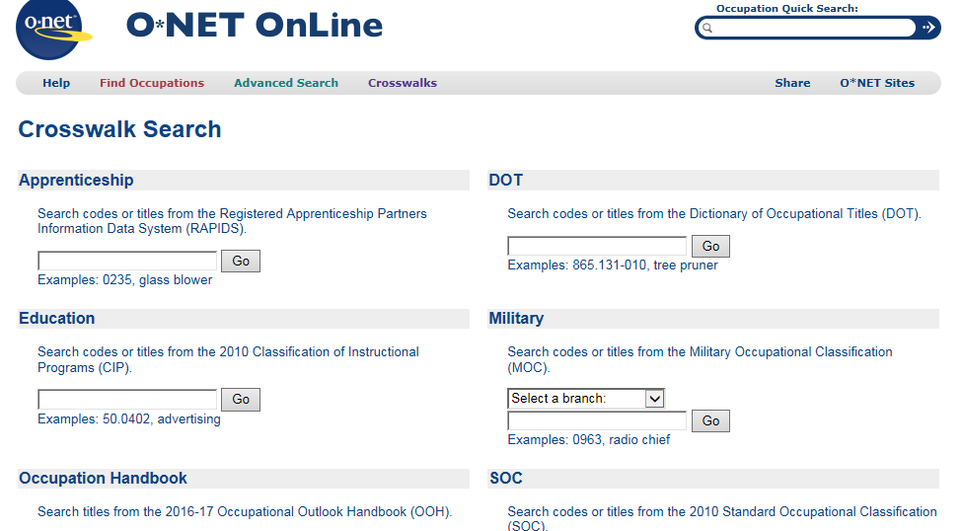
Crosswalk

Slide 11
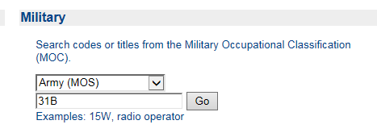
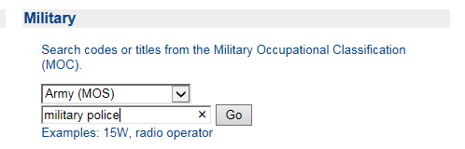
Insert Service and Title
Or

Slide 12
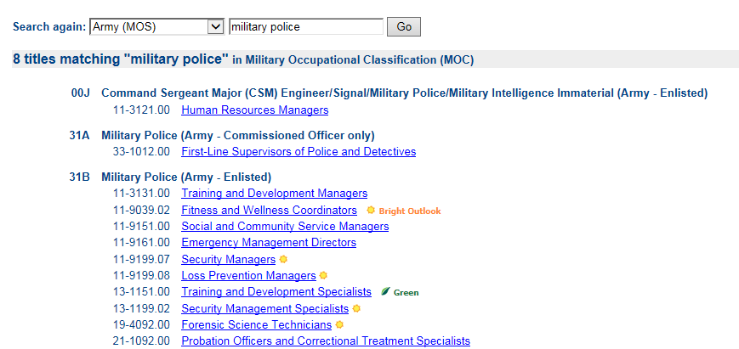
Choose the Closest

Slide 13
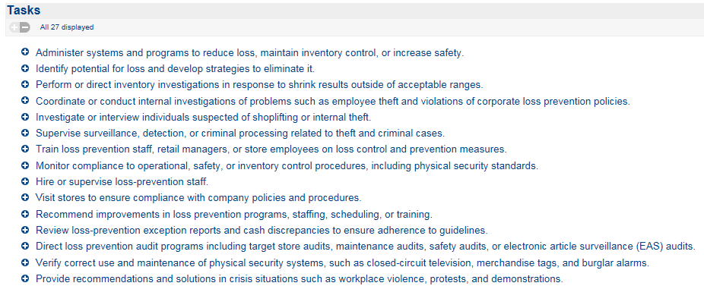
Copy and Paste to Word Document

Slide 14
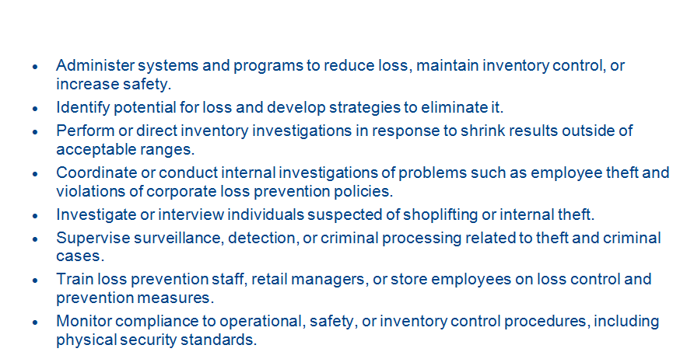
Remove the Pluses

Slide 15
Change Wording to fit You
Perform or direct inventory investigations in response to shrink results outside of acceptable ranges.
Performed inventory investigations at the local post exchange in response to management’s discovery of shrink results outside of acceptable ranges.

Slide 16
Skills Gap Analysis
Why
  Determine if the skills you possess meet the skill required for your industry
Employer’s Perspective
  #1 Complaint from employers:
    Job seekers do not articulate their skills
      Resume
      Interview
      Social Media
Notes:
Some of the employers expressed a willingness to hire veterans but reported that veterans’ skills were not applicable to their business (June 2012 Survey)

Slide 17
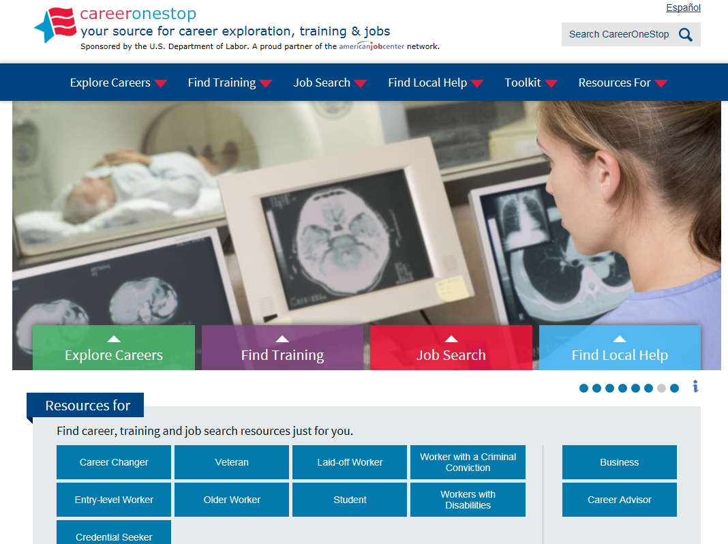
CareerOneStop.org
Notes:
Career One Stop (dot) org

Slide 18
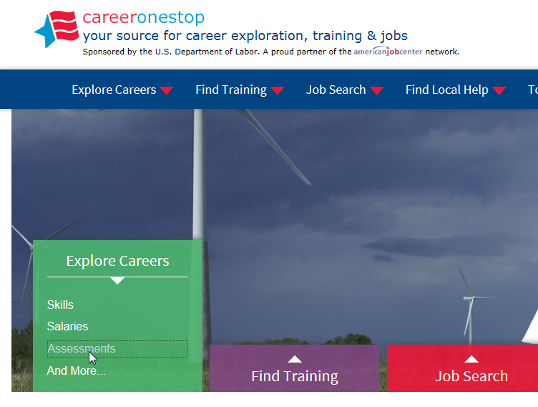
CareerOneStop.org
Notes:
Career One Stop (dot) org

Slide 19
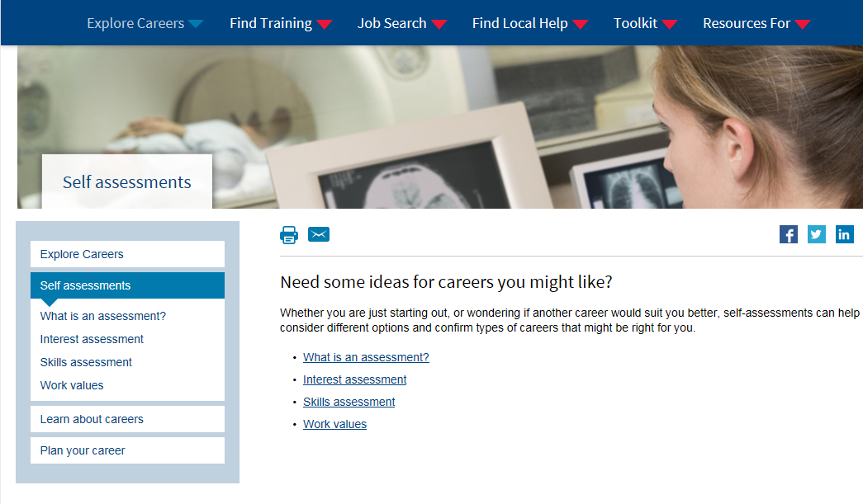
CareerOneStop.org
Notes:
Career One Stop (dot) org

Slide 20
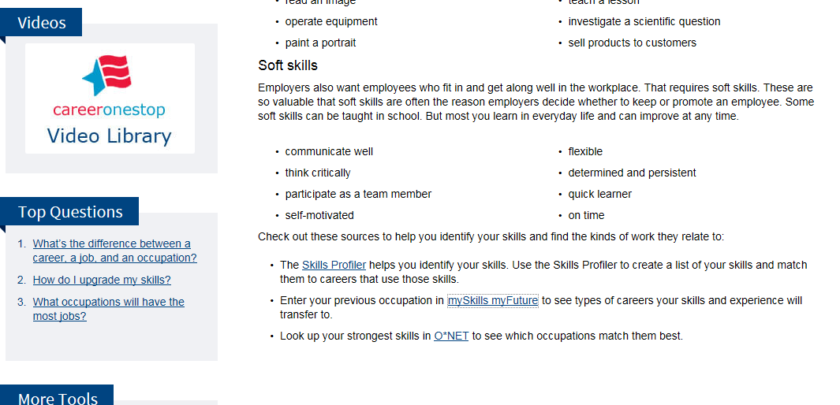
Select Skills Profiler

Slide 21
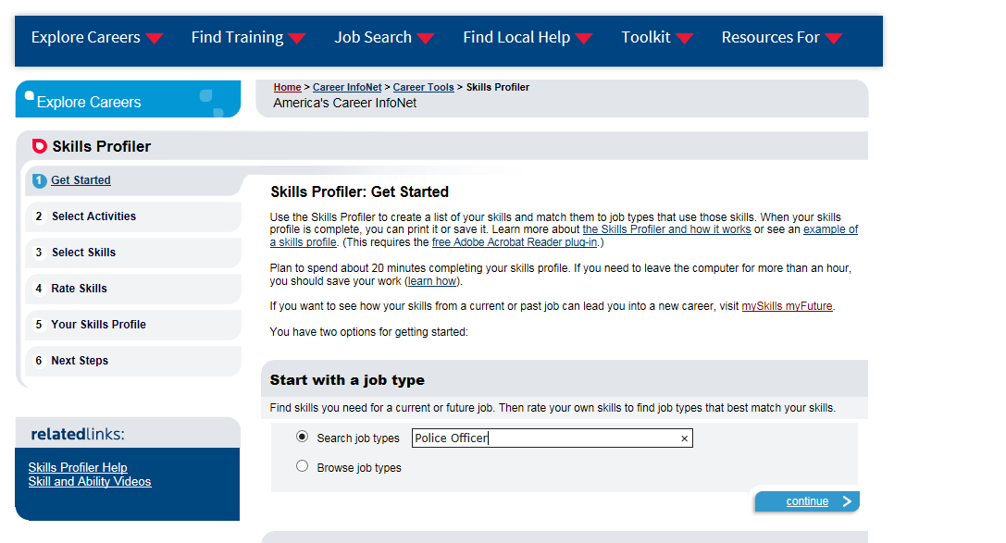
Select the Job you Want

Slide 22
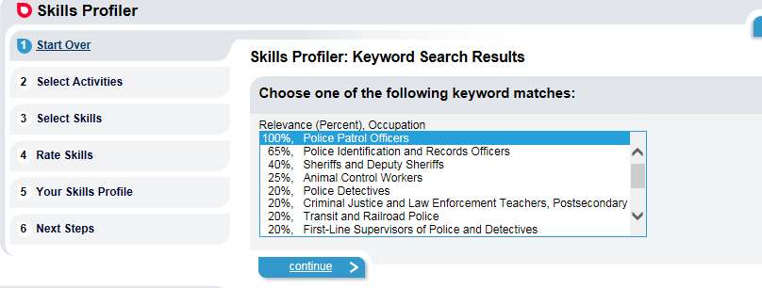
Select the one that is closest

Slide 23
Copy and Paste to Word Document
Administer first aid.
Apprehend criminal suspects.
Assist motorists or pedestrians.
Communicate situation details to appropriate personnel.
Determine operational procedures.
Direct vehicle traffic.
Inform the public about policies, services or procedures.
Inspect facilities to ensure compliance with security or safety
regulations.
Interview people to gather information about criminal activities.
Investigate accidents to determine causes.
Investigate illegal or suspicious activities.

Slide 24
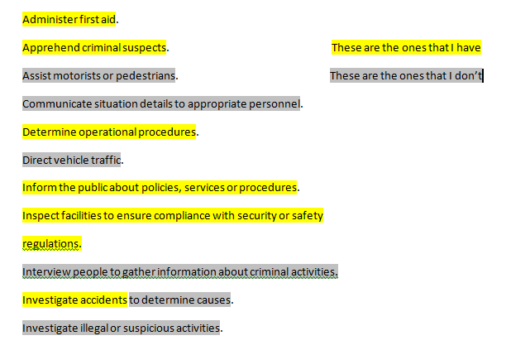
Highlight the one you have and the one’s you need

Slide 25
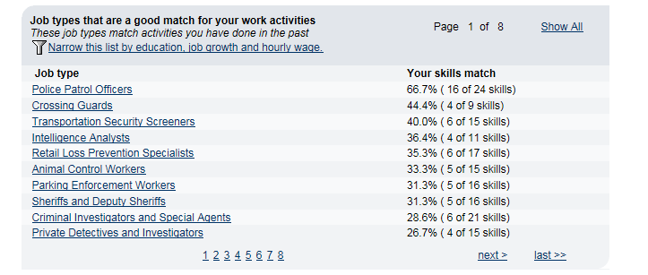
Related Occupations

Slide 26
Pulling it all Together
Military Skills Translation
Skills Gap Analysis
Understanding Skills using Wordle.net

Slide 27
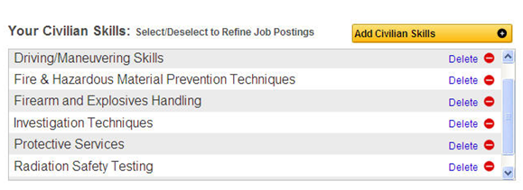
Military Skills

Slide 28
Revised
Performed inventory investigations at the local post exchange in response to management’s discovery of shrink results outside of acceptable ranges.

Slide 29
Skills Gap
Blank: | Don't have the Skill
Green: | Have the Skill
Pink: | Have the Skill, but not Proficient
Blue: | Know only this Portion
Brown: | Apply to Different Position

Slide 30

Wordle.net

Slide 31
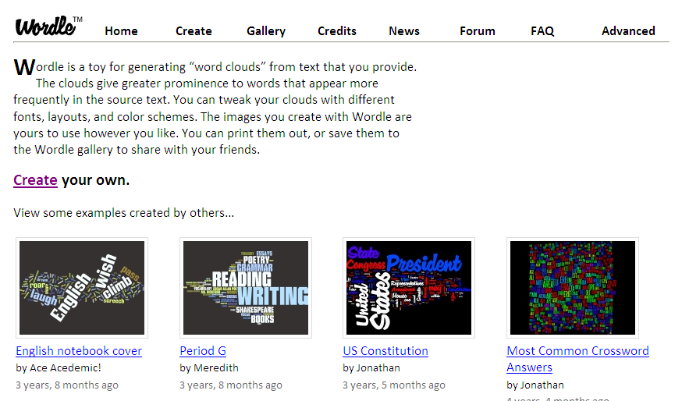
Wordle.net

Slide 32
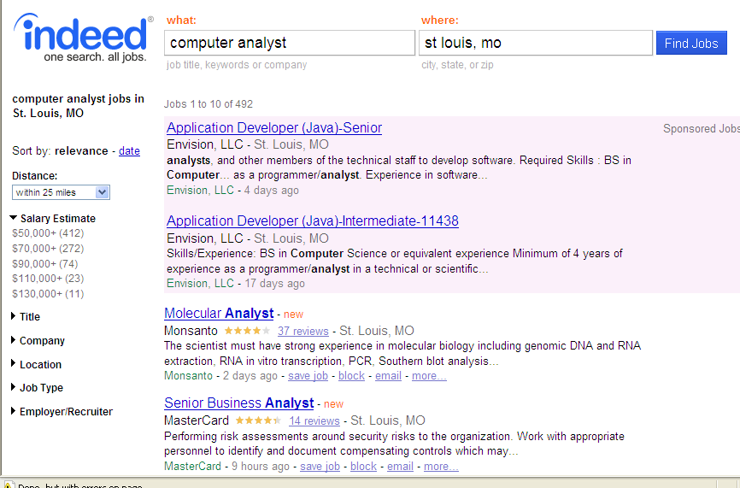
Job Announcements

Slide 33
Wordle Test
Favorite Job Portal
  Select 5 jobs from different companies
  Highlight and copy the entire job posting
    Ctrl “A” then Ctrl “C”
  Paste the entire posting into Wordle
    Ctrl “V”
Print each posting
  Change “create” to your design
Paste your entire resume into Wordle
Compare all 6 documents for Keywords

Slide 34
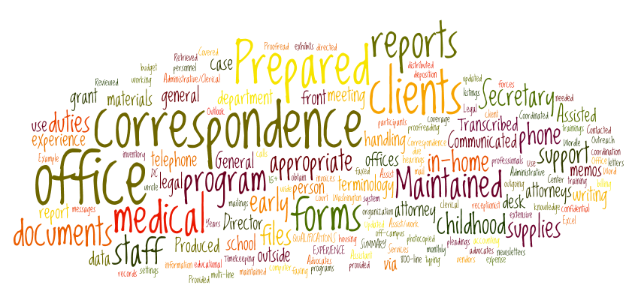
Skill Word Picture

Slide 35
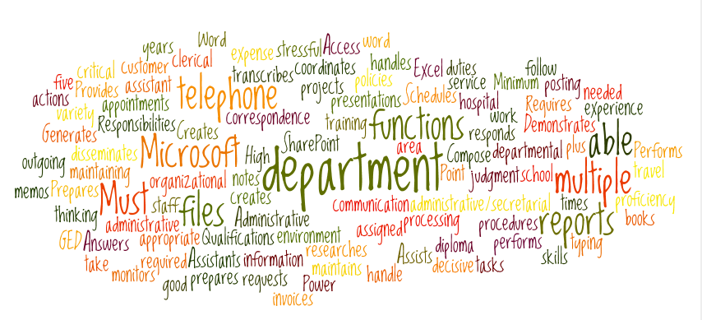
Resume

Slide 36
Side By Side
Job Listing
Resume

Slide 37
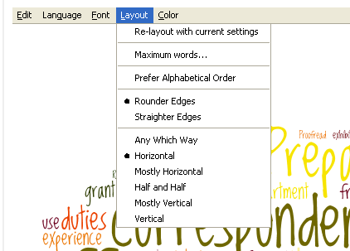
Editing

Slide 38
Career Portfolio

Slide 39
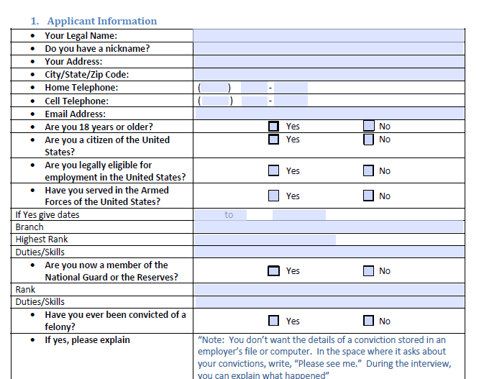
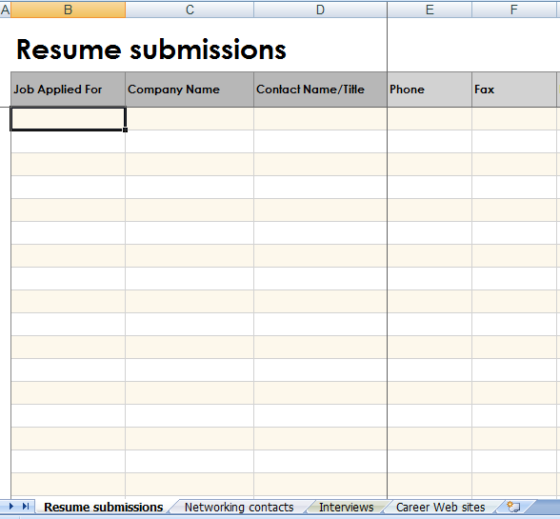
Organize Your Search
Job Application
Job Search Log

Slide 40
On-Line Job Applications

Slide 41
#1 Job Search Method
Click
Review
Apply
Pray
C R A P

Slide 42

Three Types of Resumes
Presentation
  Email | Career Fair | Networking
  1-2 pages
Civilian
  Very Specific Formatting
  2-3 pages
Federal
  Comprehensive
  Several Pages

Slide 43
Instructions?
The first step is to make sure that you understand and follow to the letter the employer’s resume and application submission instructions
Two Rules when completing an application
  #1 Read and follow all directions
  #2 If you have a problem refer to rule #1
Notes:
Format…there might be a specific format they require to read your resume or to scan your resume. Maybe they want it E-mailed as an attachment or embedded in the e-mail.
They usually include these instructions within the job requisition.
Make sure you follow these steps to the letter.

Slide 44
Just the Facts
A recent survey indicated that 93% of the Fortune 1000 companies are now using an ATS system
Microsoft receives about 50,000 resumes a month
Starbucks attracted 7.6 million job applicants over the last 12 months for the 65,000 job openings nationwide
Proctor & Gamble Inc. received nearly a million applicants for their 2,000 positions

Slide 45
Did You Know?
1 out of 3 companies do not respond to unqualified candidates
At least 75% of resumes are discarded for using the wrong words
1 out of 1000 respond to every candidate
More than 20% of the resumes are rejected for using the wrong format

Slide 46
On-Line Job Boards
How many of you have completed an on-line application and received “NO” feedback from the company?
You are asked to upload a resume and you want to attach a cover letter. Does the cover letter become the first page of the resume or the last?

Slide 47
On-Line Job Applications
Applicant Tracking Systems (ATS)
Note: This information is provided as a general reference and does not apply systemically to all ATS programs or to all companies as a whole.

Slide 48
ATS Formatting
Keywords
  Make sure your application is filled with “Keywords” that come from the job you are targeting.
  The more specific your skill set is and the more closely it’s matched to the online ad, the greater chance you have of success.
  Prioritize listings that match your skill set directly.

Slide 49
Resume |Cover Letter
Should be in a Word format.
  doc (MS2003 <earlier) vs. docx (MS2007>later) is optimal.
  PDF is acceptable with reservations.
    The only fonts that you should use in your resume are the “universal fonts.” These are the ones that open the same on PCs and Macs of all ages. These are: Times Roman, Arial, Century, MS Sans Serif, Book Antiqua, Century Gothic, or Calibri.

Slide 50
Resume
Tailor your résumé to the listing; make sure it includes keywords.
Avoid placing your contact information in the header of the resume, because filtering software could ignore headers and footers and actually delete that info.
Resume Formatting
  Do not have lines that run across the width of the page.
  Do not format using tables.
  Do not use borders around your resume.
  A one-inch margin top and bottom is best.

Slide 51
Horror Stories
  Out of every 1,000 applicants who view a job requisition only 25 will complete the application correctly and only 3-5 will be called in for an interview
  Peter Cappelli, a management professor at the University of Pennsylvania, recently noted a case after a company's resume-screening system concluded that none of the 29,000 applicants for an engineering job had the right qualifications.

Slide 52
Examples
Example #1:
  Locally conducted an experiment in late 2011 with 50 job seekers.
Example #2
  Designed an ATS program with only one set of instructions: “Type in all appropriate information”

Slide 53
On-Line Application Tips
Use Keywords found in the job description
Use correct formatting
Craft a short and targeted cover letter
Save your work frequently
Print each page prior to moving to next page
Avoid using the “back” button

Slide 54
Additional Tips
Don’t over click buttons on slow computer
Complete blank job application
Many on-line systems are timed – Plan to spend at least one hour per application
Be ready to complete an online assessment (45-60 minutes)
Don’t Assume
Follow-Up

Slide 55
Application Process

Slide 56
Application Process
Find the Position
  1st Hour – Research the company
  2nd Hour – Customize Resume/Cover Letter
  3rd Hour – Complete the ATS process
  4th Hour – Behavioral Assessment Link
  5th Hour – Follow-up
Quality versus Quantity

Slide 57
Resume Review

Slide 58
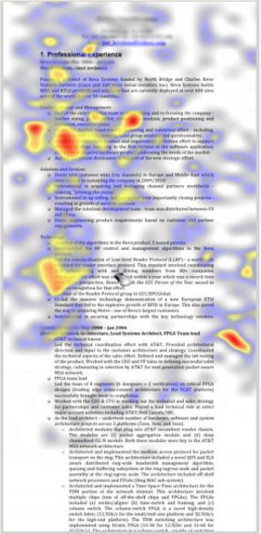
The Ladders have found recruiters spend an average of just six seconds looking at a resume before deciding ‘Yes' or ‘No' on candidates

Slide 59
Experiment
Close your Eyes, I will tell you when to open them.

Slide 60
Experience:
Identified staff vacancies, recruitment, interviewed and selected applicants which resulted in productivity increasing sixty five percent in two years.
Developed training materials and established design criteria to develop new approaches to training.
Composed educational material for use in a new engineer field which resulted in training five thousand personnel annually allowing the Corps of Engineers to conduct one hundred missions safely.
Implemented a new safety program.

Slide 61
Experience:
Identified staff vacancies, recruitment, interviewed and selected applicants which resulted in productivity increasing 65 percent in two years.
Developed training materials and established design criteria to develop new approaches to training.
Composed educational material for use in a new engineer field which resulted in training 5000 personnel annually allowing the Corps of Engineers to conduct 100 missions safely.
Implemented a new safety program.

Slide 62
Reality of Today’s Job Search
Interviewed over 180 Hiring/HR Managers
  Number One Complaint
    Communication Skills
      Inability to articulate skills
        Resume
        Applicant Tracking Systems
        Interviews (Telephonic | Seated)
        Social Media

Slide 63
“Searching for the best talent that fits our culture”
Senior Talent Acquisition Manager – St Louis Fortune 500 company
Culture
Skills
Education
Today’s Talent

Slide 64
Top Ten Signs Your Resume Needs Updating
The title is …… Resume
  Make the title your name and make sure the file name is your name as well.
It’s only one page
  The rule of thumb is, the longer the career, the longer the resume so go ahead and fill out what you have done and if it lands at 2 full pages that is fine (as long as it’s relevant information).

Slide 65
You have included age, height, weight, and marital status
You have a photo
Your resume lacks social media contact details
  To indicate how tech savvy you are, you will want to include your LinkedIn and other professional networking details

Slide 66
Objective Statement
  You should focus on what you can do for the company, tune in to their WIIFM and entice them to get you in for an interview
  The cover letter is an excellent place to tell the world your reasons for wanting this job.
You’ve listed all your jobs
Terminology
  Use their words not yours

Slide 67
References available (and happily supplied on request)
  No need to write that in your resume, it’s only wasting space. Surely this is implied when you apply for a job anyway?
Submitting the same resume to each job posting
  Your resume is a living document that needs to be tweaked, fine tuned or calibrated for each job you apply for!

Slide 68
30 Second Resume Test
Hold the 1st page of your Resume and fold the Header (name, address, etc.) back so it’s no longer visible.
Fold the employment section of your resume back so it too is no longer visible.
What you have left is your 30 second resume review.

Slide 69
Understanding Job Postings
Most Job Posting contain three sections
Company Information:
  Overview of the company mission and basic information pertaining to the company goal in hiring a qualified applicant
Job Description:
  Overview of the position and some of the day to day job duties for the position the company is trying to fill
Position Requirements:
  Qualifications an individual must possess prior to applying for this position

Slide 70
Read the Job Posting from beginning to end
Select and highlight the top ten (10) items from the entire posting that you feel the employer is looking for in a qualified candidate.
These selections from you are subjective and may not reflect 100% of what the employer is actually looking for.
Then look at your resume…how many of the top ten items that you selected for this position are reflected in your resume and cover letter?

Slide 71
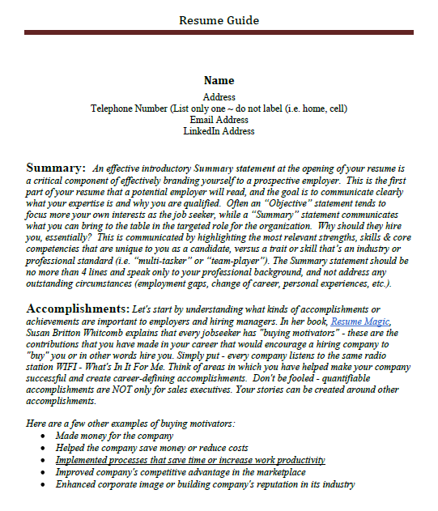
Resume Guide
No objective statement
Once you graduate move education to last item on resume
Summary of Qualifications
Accomplishments
Skills Section
It’s not about what you’ve done in the past it’s about what you bring to the table for that employer!
Match your resume to the job posting!

Slide 72
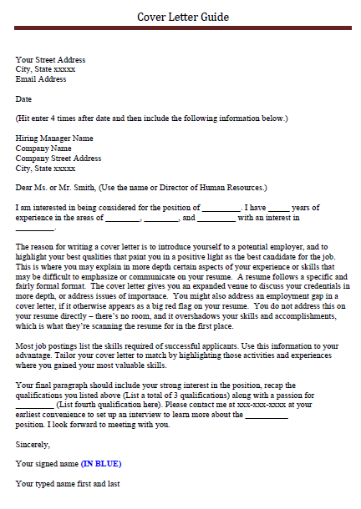
Cover Letter Guide
Complete name/address including email
Date
Hiring Manager ~ HR/Personnel Manager ~ Internal Point of Contact ~ Complete Name
Complete Company Address
Greetings
Name of Position and Position Number
3 Qualifications per Job Postings
Employment Gap Explanation more than 6 months
Highlighted skills tailored to position
Recap 3 qualifications and one qualification that you feel is your strongest not required by position
Sign in Blue

Slide 73

Interview Techniques

Slide 74
Interviews
Do your homework first!
The interview starts when you arrive in the parking lot!
Turn cell off
Dress for Success!
Meet and greet everyone
Resume
Ask Questions
Follow-up!!!!!

Slide 75
Most Harmful Common Mistakes
3,000 Employers
Answering cell phone or texting: 77%
Appearing disinterested: 75%
Dressing inappropriately: 72%
Appearing arrogant: 72%
Talking negatively about current or previous employers: 67%
Chewing gum: 63%

Slide 76
Interview Mistakes
Candidate brought a “how to interview” book with him to the interview.
Candidate asked, "What company is this again?”
Candidate put the interviewer on hold during a phone interview. When she came back on the line, she told the interviewer that she had a date set up for Friday.
Candidate wore a Boy Scout uniform and never told interviewers why.
Candidate talked about promptness as one of her strengths after showing up ten minutes late.
Candidate took off his shoes during the interview.
Candidate asked for a sip of the interviewer's coffee.
Candidate told the interviewer she wasn't sure if the job offered was worth "starting the car for.”

Slide 77
Networking

Slide 78
Networking
Most Veterans are well aware that networking is critical, but it can be intimidating.
Even people who enjoy being social can find themselves tongue-tied when they have a goal in mind other than just chatting.
Networking can be more enjoyable if you do a couple things ahead of time.

Slide 79
Have Fun
Don’t take networking too seriously. It can and should be fun.
Connect with the intention of helping others rather than simply expecting to find the elusive perfect job.
Relax, take the pressure off yourself and focus on what you can bring to the party or offer in the form of contacts, knowledge or resources.

Slide 80
Tips
Keep the alcohol consumption to a minimum if you’re at an event where it’s being served.
Be the person to include others into the conversation when they join the circle.
Be polite and considerate.
Be sincere, open and follow through on your commitments.

Slide 81
Getting the Conversation Started
The key word here is “conversation”
  Greeting
  Introduction
  Connections if any
  Appreciation for the encounter
Try to make contact with 3 new people
Follow-up

Slide 82
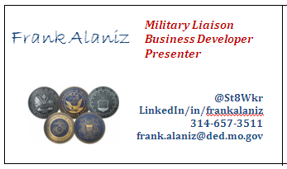
Must Haves
Business Cards

Slide 83
Elevator Speech

Slide 84
Elevator Speech
Jobseekers should have a concise summary of their core skills and accomplishments that they can deliver to anyone who will listen in a small window of time
However, it is often used incorrectly.
When not done right, this little speech can kill your chances for further discussion, let alone finding a job lead.

Slide 85
Tips
Do not lead with your pitch
Build rapport and create a relationship before pitching yourself
Customize your pitch
Do not pitch yourself randomly, anywhere, anytime, to anyone
Make it a two way conversation
Gauge the response,
  pause, ask a question, listen, and learn more

Slide 86
The Perfect Elevator Speech
Crafting an elevator pitch is a good exercise because it forces a job seeker to concisely state his or her brand and value. Make sure you can clearly articulate who you are and what you can do. When it’s time to share that information, share it as part of relationship building and problem solving.

Slide 87
Format It
A good pitch should answer three questions:
  Who you are
    Hello my name is Gary Jensen.
  What you do
    I’m a Workforce Development Specialist 4, specializing in training.
  What you are looking for
    I’m looking for a Training Development position with emphases on instruction.

Slide 88
Tailor Your Speech
Tailor the pitch to them, not you
  It’s important to remember that the people listening to your speech will have their antennas tuned to WIIFM (What’s in It for Me?)
So be sure to focus your message on their needs.

Slide 89
Example
I’m a human resources professional with over 10 years experience in governmental agencies.
OR
I’m a human resources professional with a strong track record of helping to identify and recruit top level candidates.

Slide 90
Eliminate Industry Jargon
You need to make your pitch easy for anyone to understand, so avoid using acronyms and tech-speak that the average person or job interviewer might not understand.
The last thing you want to do is make your listener feel stupid or uninformed.

Slide 91
Tips
Read your pitch aloud
  If you’re not careful, your elevator pitch can come off sounding more like an infomercial than a conversation.
  Reading it aloud then tinkering with the words will help you sound more authentic.
Practice, Practice, Practice
  Then solicit feedback.
  Keep tweaking your pitch until it no longer sounds rehearsed.

Slide 92
Tips
Prepare a few variations
  Specific to industry
  Generalize for informal audiences (job fairs)
  Master key talking points
Nail it!
  When you give the speech, look the person in the eye, smile and deliver your message with a confident, upbeat delivery

Slide 93
Social Media

Slide 94
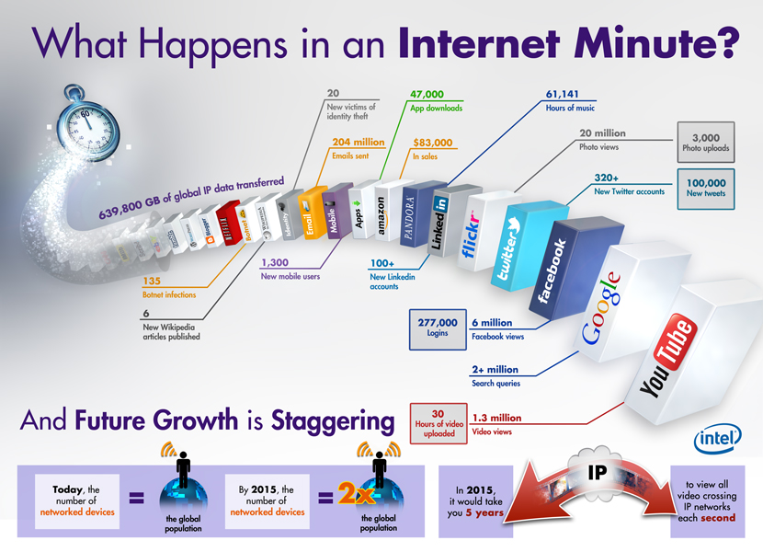
2013

Slide 95
Top 1,000 U.S. Employers
25% have a FaceBook business page
75% have a LinkedIn business page or
  Use LinkedIn for recruiting new talent
25% have a Twitter account
100% have a Social Media Manager
100% have a Listening Manager

Slide 96
Social Media
#1 Job Search Board?
Facebook!
Monster?
Career Builder?
Indeed?

Slide 97
The Job Search: Social Media Considerations
Use Facebook, Twitter, and LinkedIn to Network Your Way into a Job. Here are a few smart and strategic ways to use these popular online tools…
Facebook
  Don’t make the mistake of overlooking your network on Facebook, especially if you already have hundreds of friends. Facebook can sometimes be more useful for job hunting than LinkedIn, because friends who know you personally have more of a stake in helping you.

Slide 98
Social Media
Twitter
  The #2 social media site, nearing 300 million users. TweetMyJobs.com announced that 84,000 jobs were tweeted in a recent 24-hour period and 1,840,000 jobs were tweeted in the last 30 days.
LinkedIn
  The #1 professional networking site. With over 100 million users, it’s a major resource for recruiters and HR professionals seeking potential candidates and verifying credentials.

Slide 99
Tips
Professional email address
Let people know you are looking for a job and what type of job you are looking for
Build relationships
Post
  9 minutes a day
  Likes
  Follows

Slide 100
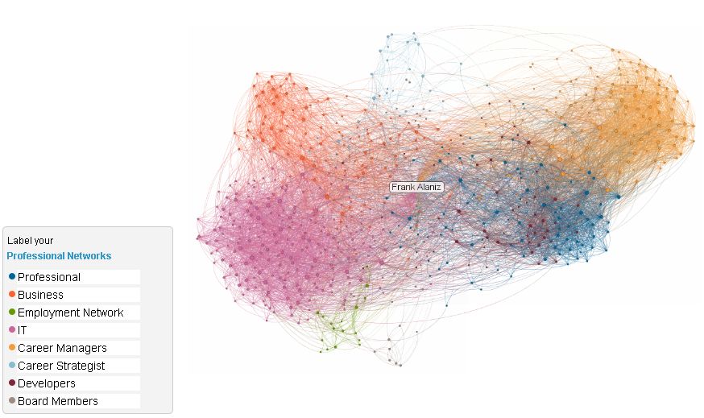
85% of all jobs are found through Networking!

Slide 101
Final Checklist
Pre-deployment, re-deployment, and everywhere in-between; Active Duty, Reserve Component, or fully-separated Veteran… wherever your place in life, embracing your job search can help accelerate the journey.
Develop an action plan and take advantage of all tools and resources at your disposal. If you’re unemployed or under-employed during this process, treat the search for employment like it’s your full-time job.

Slide 102
Make contact with a Disabled Veterans Outreach Program (DVOP) Coordinator. Register with our online career assistance resource, MoJobs.
Get your résumé in order. ‘Civilianize’ the document by translating your military experience into civilian terms (lose the jargon & acronyms). Create a master version, but customize your résumé for each job application.
Prepare your elevator speech (30-second commercial) and sharpen your interviewing skills. Continually rehearse answers to anticipated questions. Research the company & industry

Slide 103
Register with other job assistance organizations & sites, such as USAjobs, MoJobs, and Clearancejobs . Take advantage of their technology, expertise, and network.
Capitalize on social media during the job search, to include cleaning up your online content. Consider joining LinkedIn and using Facebook and Twitter in your job search.
Obtain certification or licensure in your career field to be more competitive. Consider scheduling National Career Readiness Certificate testing to prove you have the skills for the job. Request training in high-demand industries at your Missouri Job Center.

Slide 104
Dress for success. Acquire the wardrobe necessary to make a great first impression during the interview (at least one step above the dress required for the job).
Conduct follow-up activities. Send thank-you notes after the interview. Review your performance to learn from your mistakes. Learn how to evaluate and negotiate job offers.
Utilize the resources we’ve provided you today.

Slide 105
Links
Missouri Job Centers
Missouri Web Portal
www.Jobs.Mo.Gov
jobs.mo.gov/jobseeker/veteran-employment-services
Military Job Portals
www.H2H.jobs
www.ESGR.mil/Missouri

Slide 106


Questions?
Missouri
Workforce
Development
@ShowMeHeroes
@JobsMoGov

Slide 107

Presentation Developed by:

